Slide 1



Techniques for Authentication of Mobile Devices
Cybersecurity for Embedded Systems
Track 9 – Group b
Perno Andrea – 296185
Sciara Lorenzo – 303462
Scicolone Omar – 296492
Spinello Basilio – 292856

Slide 2
Goal of the project
Prove data origin from a specific device to an external verifier
Utilize unique properties of the device (codes, IDs, etc.)
Achieve "beyond reasonable doubt" data authentication
Develop a protocol meeting the goals
Assumption:
Verifier has access to the device to confirm authenticity.

Slide 3
Unique IDs
Hardware | Software | SIM related
IMEI | Advertising ID | ICCID
Serial Number | UUID | IMSI
MAC | Firebase ID | PhoneNumber
 | DRM

Slide 4
Decision Criteria
Uniqueness
Readability
Persistency

Slide 5
Decision Criteria
Uniqueness
Adv ID
•
IMEI
•
•
MAC
UUID
•
•
Serial Number
Firebase ID
•
•
•
•
Readability
ICCID
IMSI
Phone
Number
Persistency

Slide 6
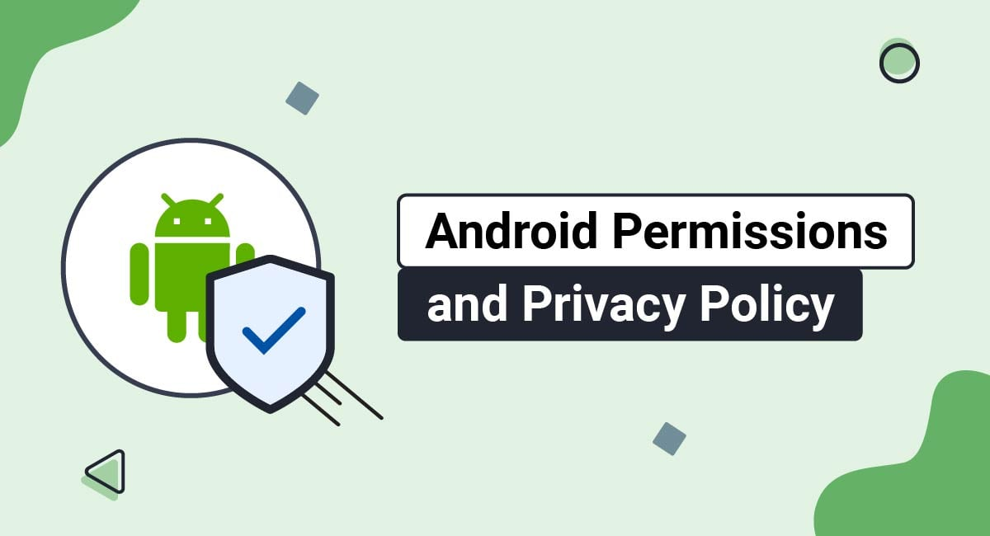
Best practices for unique identifiers
«Avoid using hardware identifier, choose instead user-resettable identifiers whenever possible»
(from Android Documentation)
READ_PRIVILEGED_PHONE_STATE

Slide 7
Our approach
Cryptographic operations of the smartphone
Trusted Execution Environment (TEE) and Android Keystore System
TEE-based Hardware-backed Key Attestation
Management and analysis of cryptographic keys and certificates

Slide 8
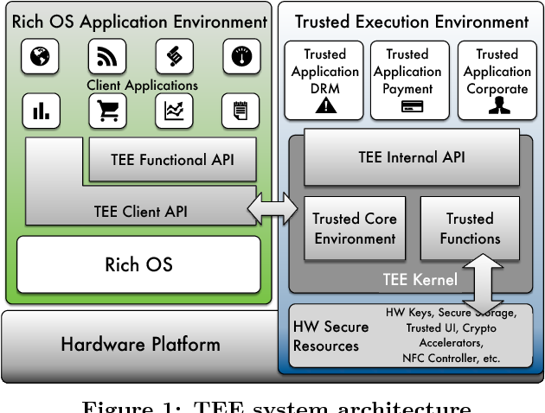
Trusted Execution Environment
Main properties:
Hardware isolation
Secure Data Storage
Cryptographic engine
TEE-backed unique Key pair

Slide 9
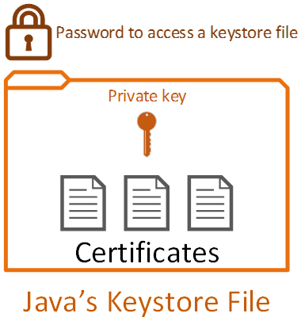
Android KeyStore
Android abstraction of TEE
Main properties:
Secure key matherial storage
Prevention from unauthorized usage of the keys
Cryptographic process separation
Bounded to the TEE

Slide 10
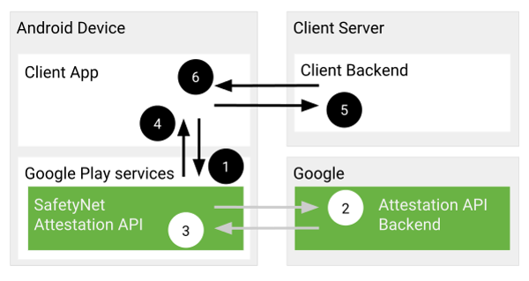
Android Key Attestation
Each key pair have a Certificate Chain
Export certificate chain to the verification server
Verify Digital Signature for sender authentication
Verify Certificate Chain

Slide 11
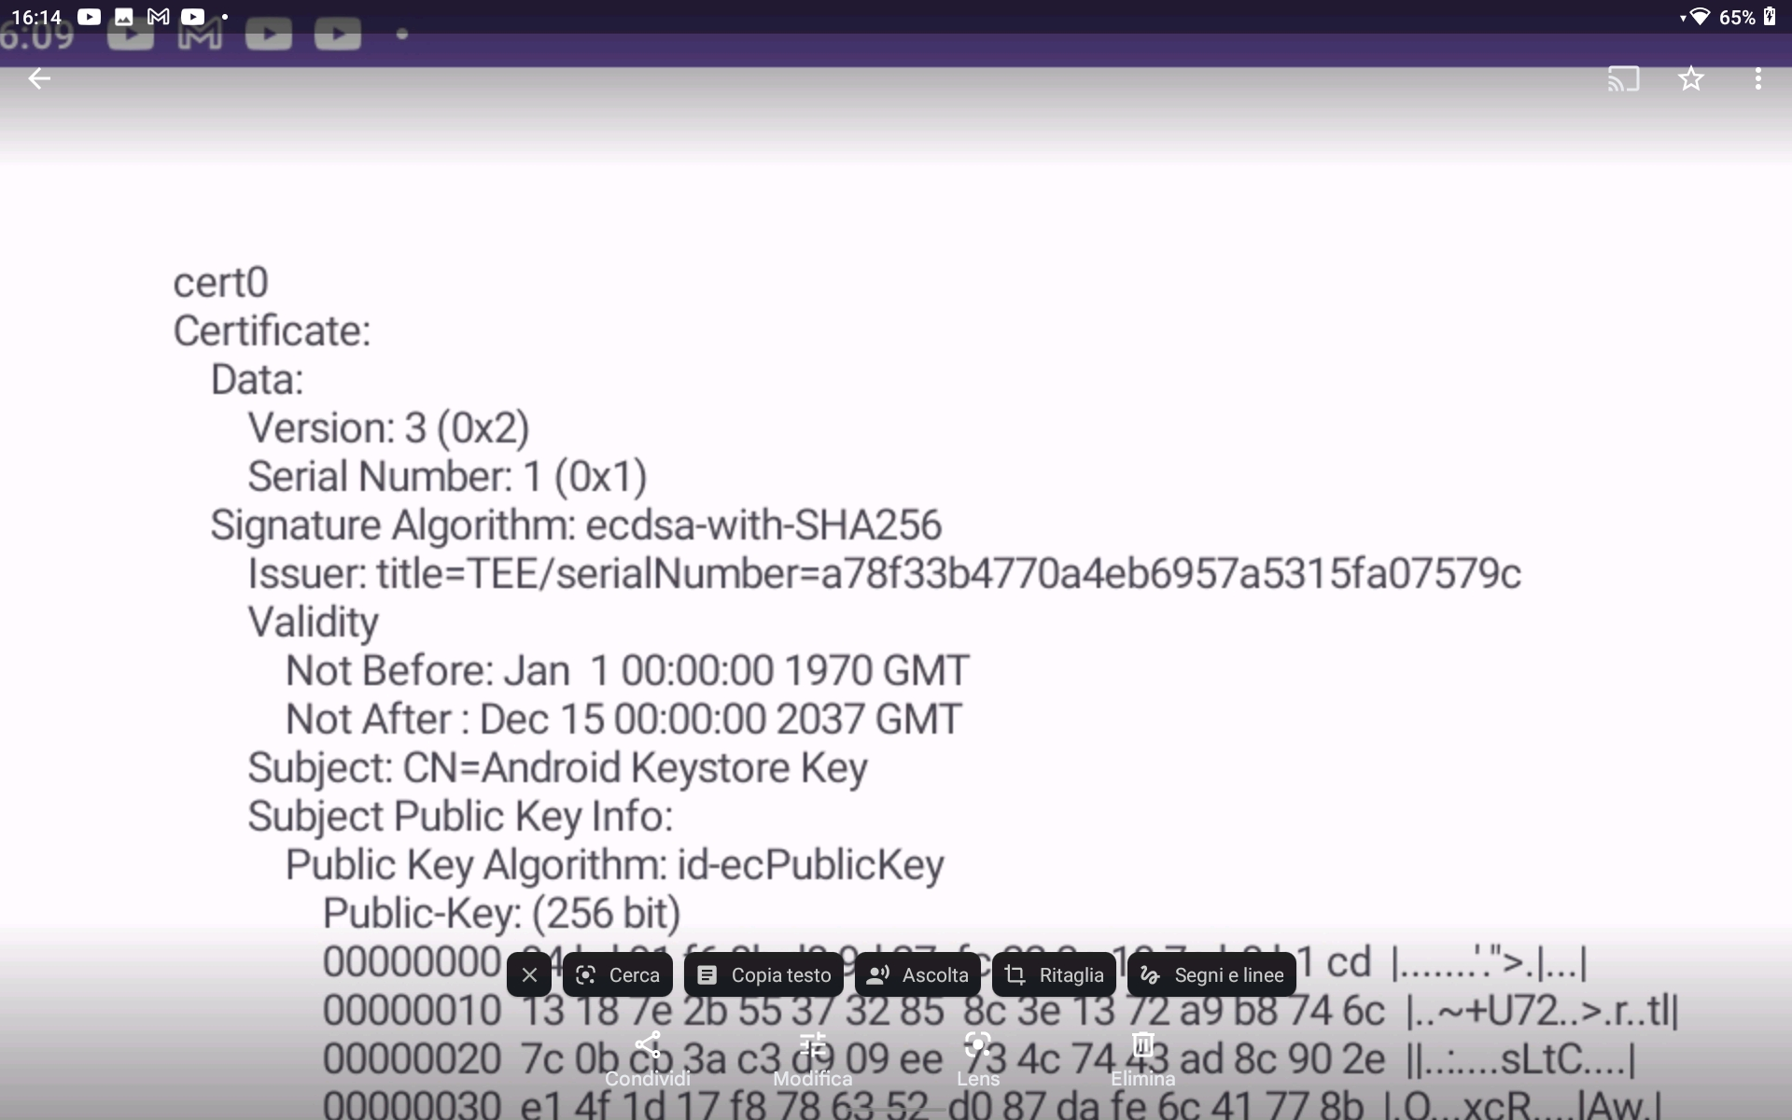
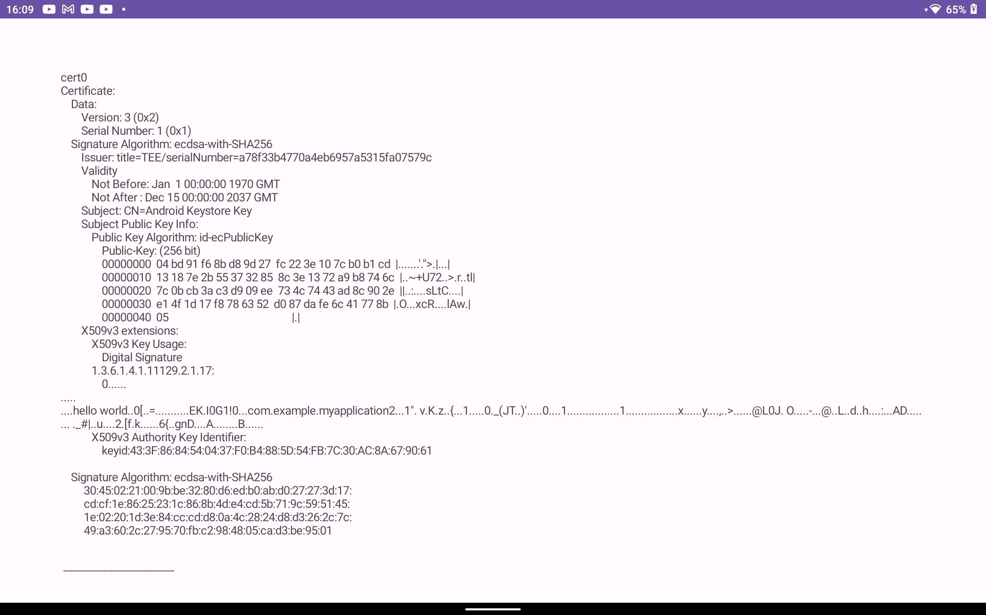

TEE Serial Number
Extract TEE S/N from certificate 0
Compare it to the actual stored one

Slide 12

Implementation Schema
3. Send computed
Signature and Key
certificate chain
2. Signature
generation
4. Verification
phase
1. KeyPair
generation
Client
5. Send back
verification results
Server

Slide 13
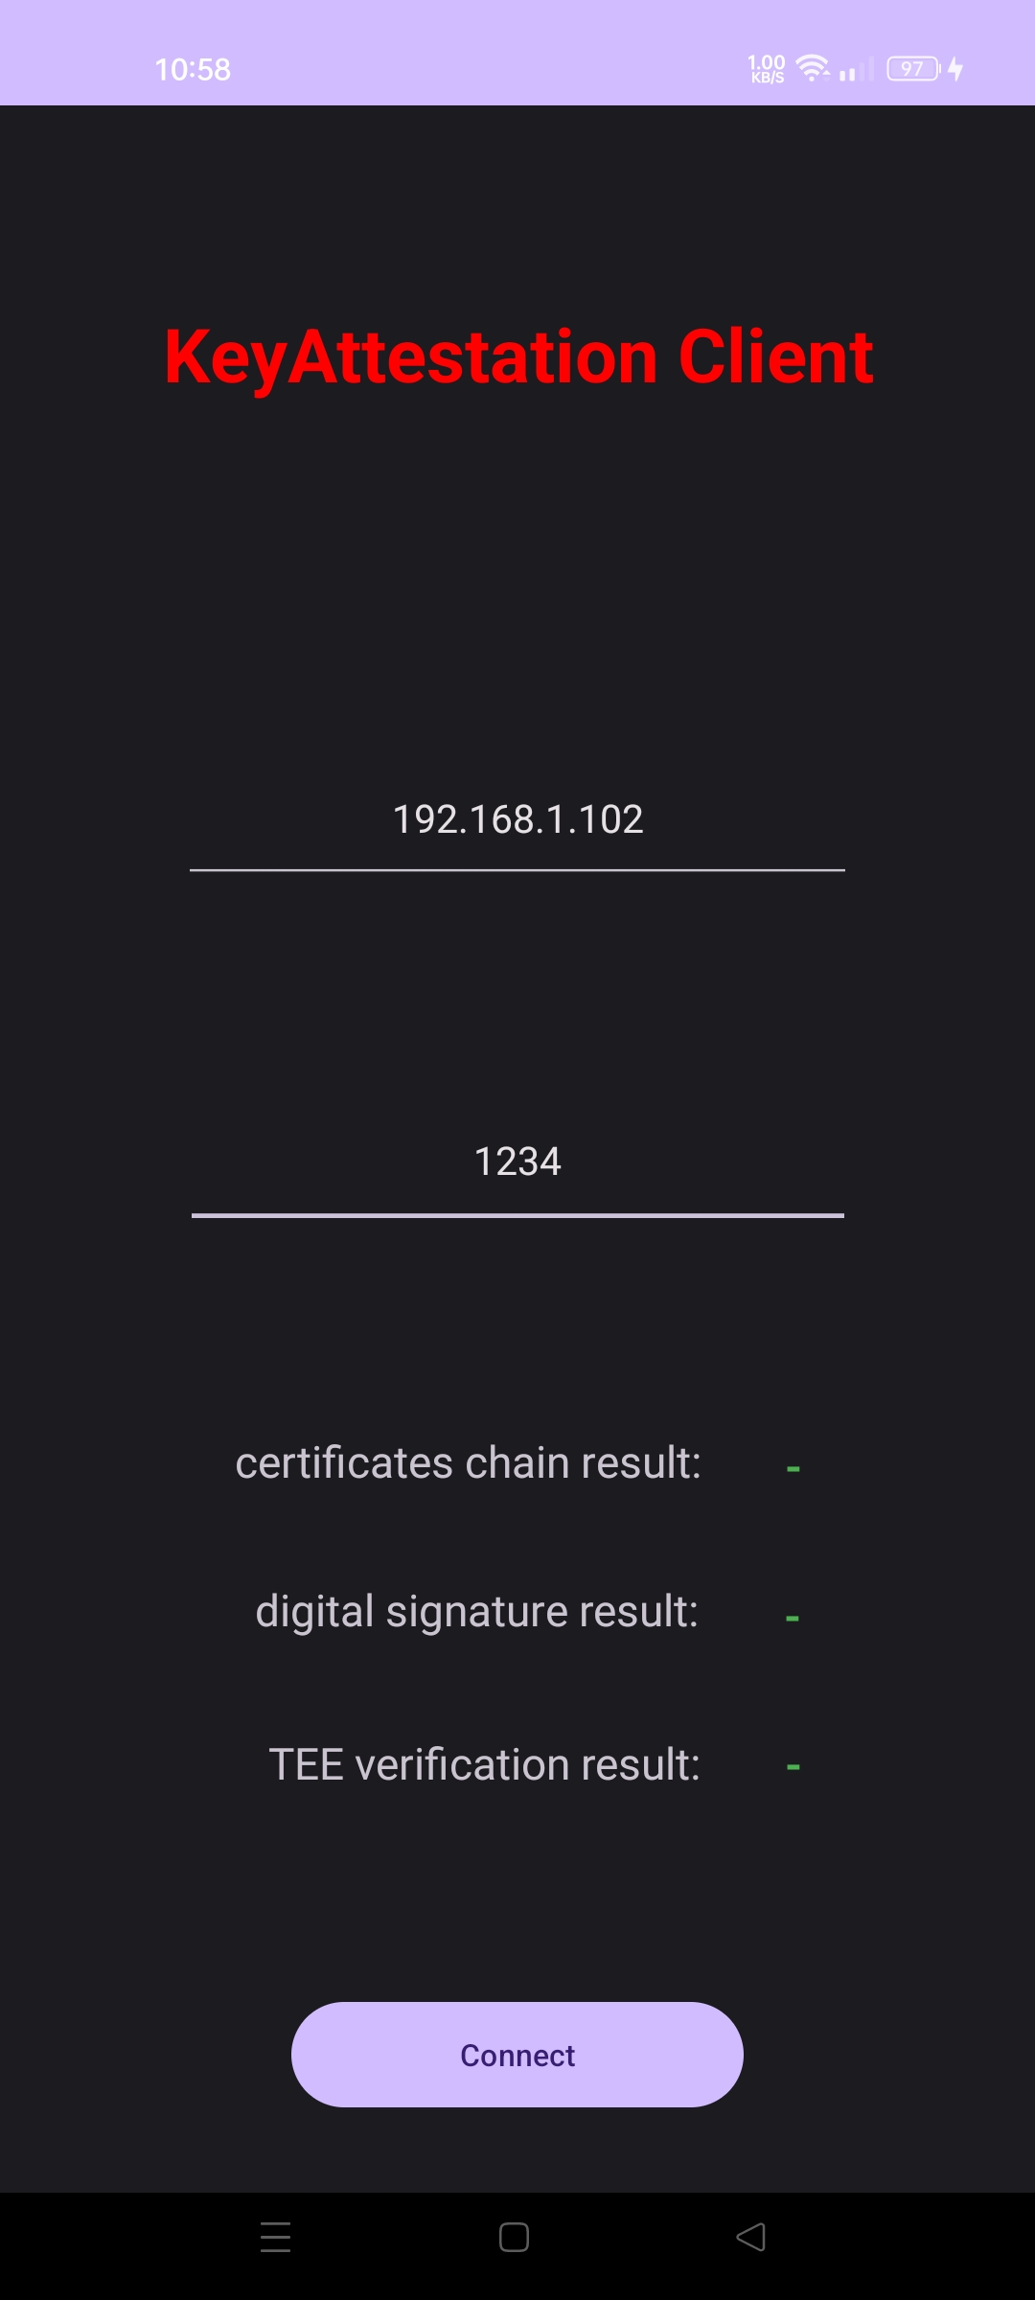
Client Implementation
Generation of the Key Pair
Sign data with the private key
Send signature and Certificate Chain to the Server
Wait for response

Slide 14
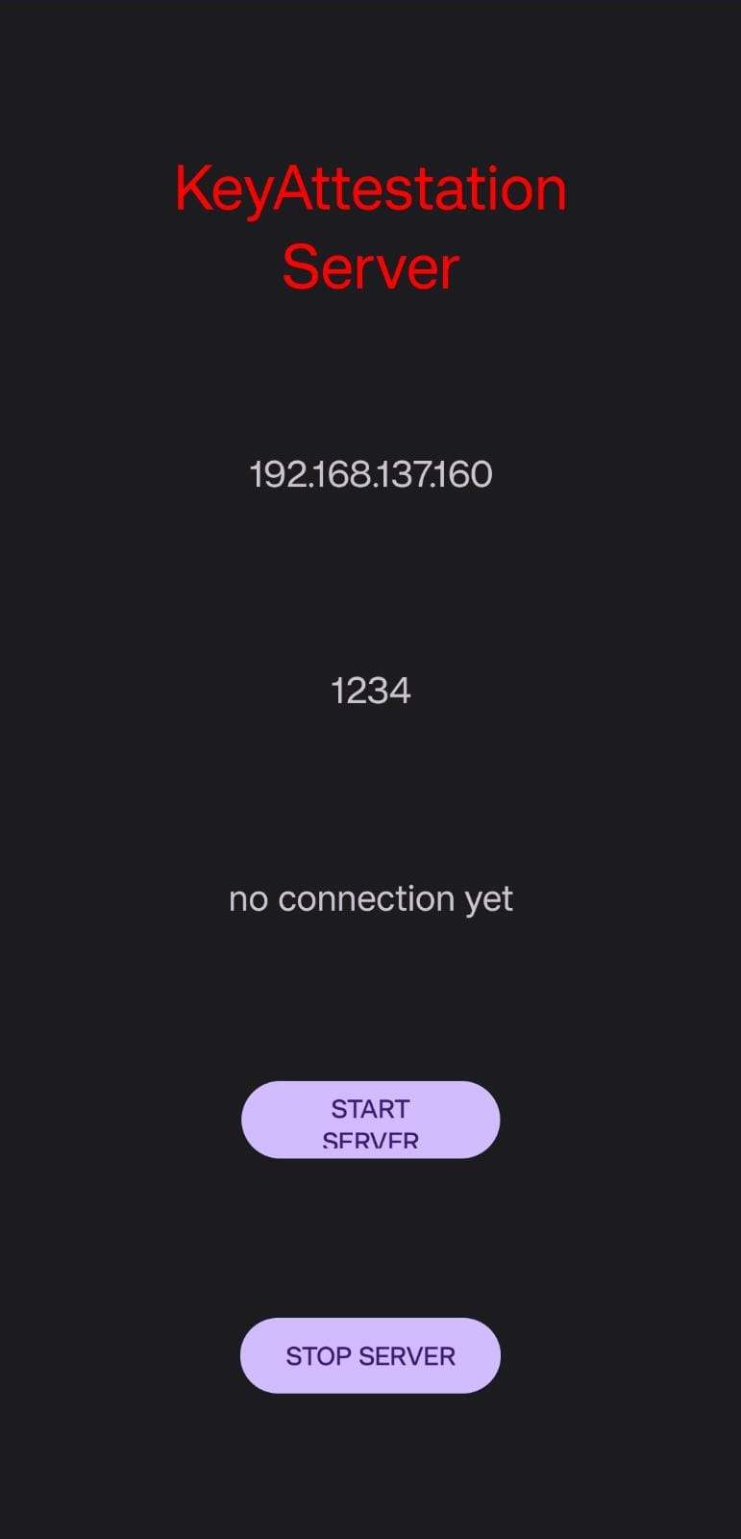
Server Implementation
Receives signature and Certificate Chain
For each certificate:
Check validity
Check integrity
Check revocation status
Check signature value
Compare TEE Serial Number
Send results

Slide 15
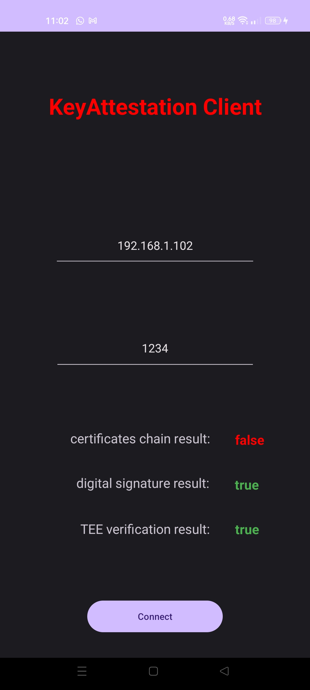
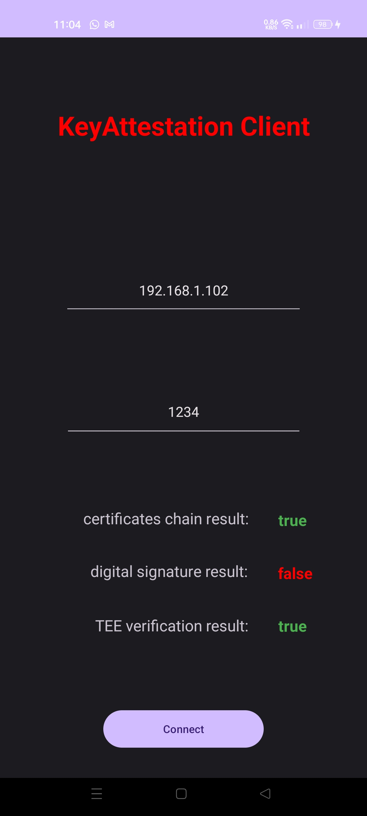
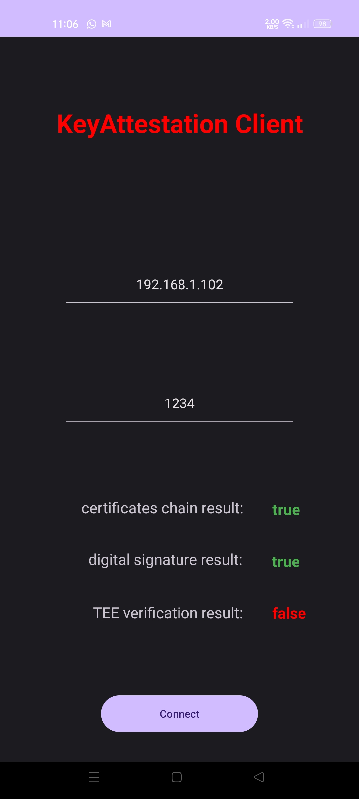
Demo - Client Errors

Slide 16
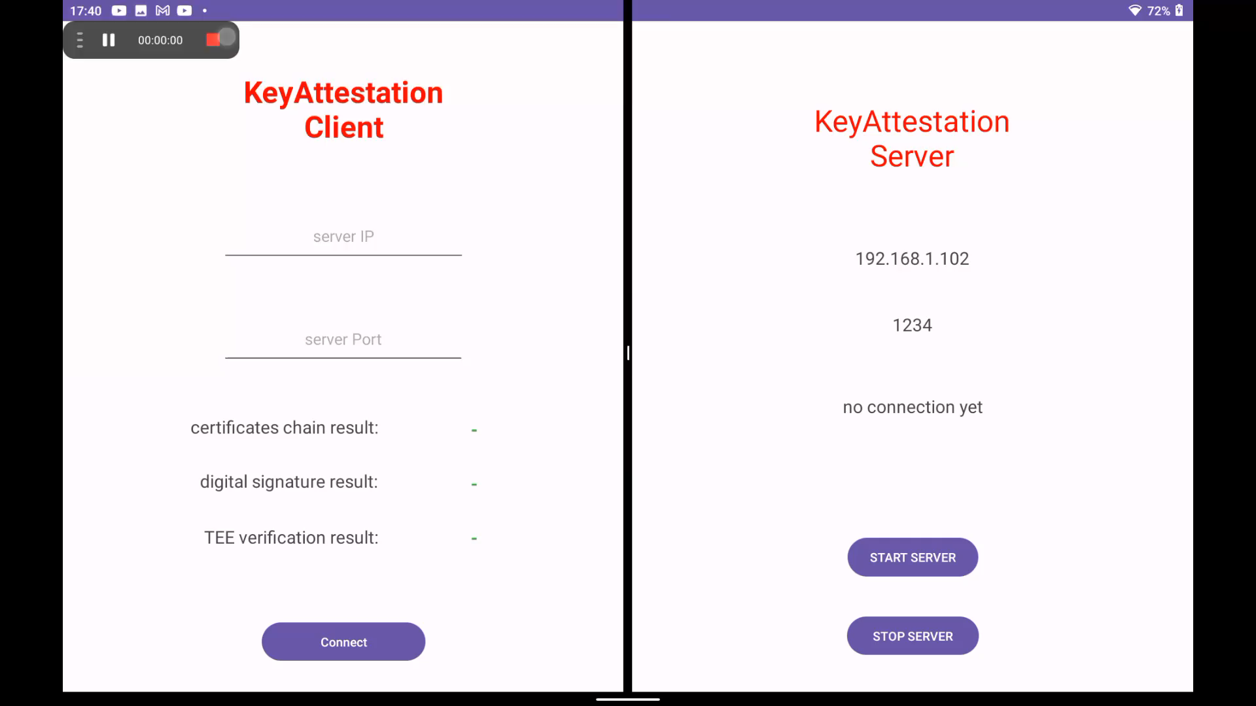
Demo - Video

Slide 17
Summary
We are able to:
Client side:
Generate a Key Pair for asymmetric digital signature
Retrieve Public Key certificate chain
Sign some data
Server side:
Verify the integrity of data and certificate chain
Authenticate the sender device with TEE S/N

Slide 18
Possible Extensions
TEE Serial Number database
Signature of generic data
Automatic identification of the Server (private network)
Extension to public IP network

Slide 19
Bibliography
Android Identifiers:
https://en.proft.me/2017/06/13/how-get-unique-id-identify- android-devices/
https://ehsanet.medium.com/android-unique-device-id-history- and-updates-7667b38e4ee2
Best Practices for Android unique identifiers:
https://developer.android.com/training/articles/user-data-ids
Android KeyStore:
https://developer.android.com/training/articles/keystore
Android Key Attestation:
https://developer.android.com/training/articles/security-key-attestation

Slide 20

Thanks for the attention!
Perno Andrea – 296185
Sciara Lorenzo – 303462
Scicolone Omar – 296492
Spinello Basilio – 292856

